Slide 1
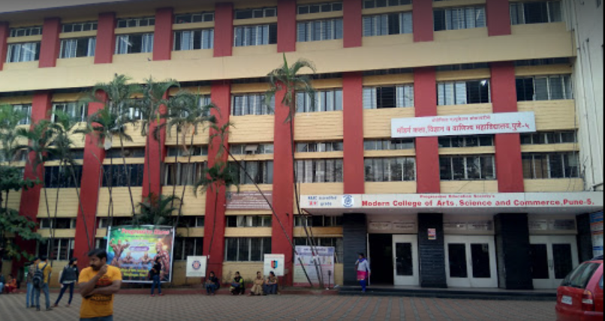

Department Management System(college)
Web Application…
Presented by : Vaishnavi Lashkare..
Aditya Chavhan..

Slide 2

AGENDA
Project Description
Project Scope
Database Design
E-R Diagram
DFD
UML Diagrams
Conclusion

Slide 3






Project Description
Academic Help:
Student can easily fill all the exam form or pay fees in online mode or Get Hall ticket or imp document..
Enhance College Management: We made a simple website to help run colleges better.
Modern WEB
Enhance Communication:
Our website makes it easy for students, teachers, and Admin
to talk to each other.
Keep Things Sorted:
Our website helps you find important stuff easily, like Assignment Notes, And your result ,Imp Notice..
Getting Things Done Faster:
You can quickly check your class schedule and communicate with teachers and see class material
without any trouble.

Slide 4




Scope
01
02
03
STEP
04
It makes things easier for teachers in organizing all student-related activities.
- Features may include messaging, assignment submission, grading, scheduling, etc.
It is More efficient & Convenient for college.
It reduces the manpower in the department because Software does all tasks easily in online mode.
- The web application will facilitate communication between students, teachers, and administrators within a college.
- Users will have different roles and permissions based on their status as students, teachers, or administrators
Student Management: Simplify login, schedules, grades.
Communication Hub: Connect assignments, records, discussions.
more
more
more
more

Slide 5



Language Used For Development
HTML
CSS
Java script
PHP
(Hypertext preprocessor)
Postgres SQL Database
Front End
Server Side
Backend

Slide 6

ER Diagram
ER Diagram stands for Entity Relationship Diagram that displays the relationship of entity sets stored in a database.

Slide 7
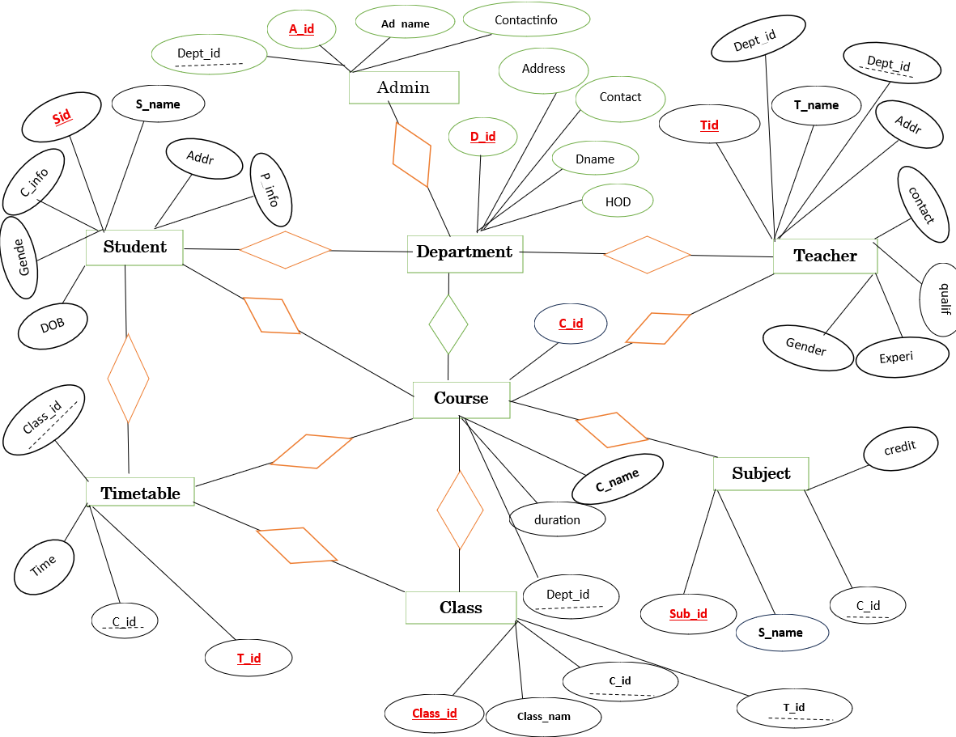



M manage 1
Gender
M belongs 1
1 Work in M
1 Enroll in 1
1 Teaches M
1 offer M
1 follow 1
1 include M
1 follow 1
1 consist M
1 Scheduled on 1

Slide 8
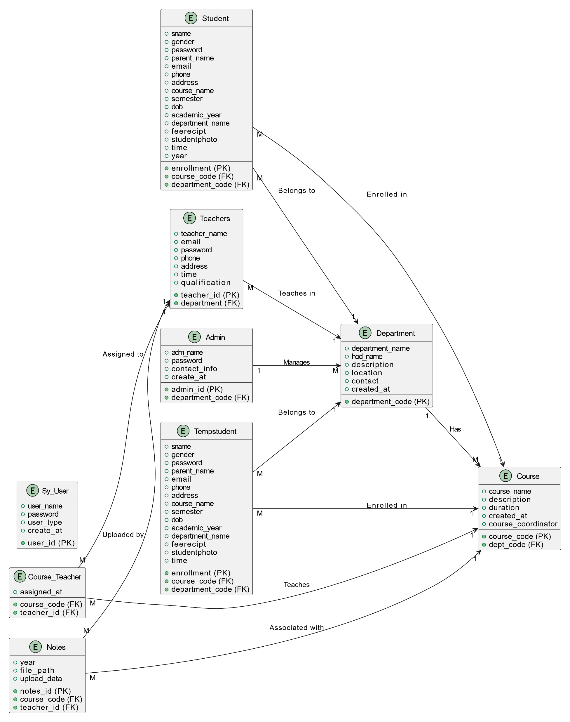

Slide 9
Database Design
Student
Field(column) | Datatype | Description | Constraint
Student_id | integer | Unique id | Primary key
S_name | String | Student name
Address | String | Stud address
contact_info | long int | Phone no | Unique
DOB | date | Student age
Gender | string | Gender of student
Parent_info | string | Parent information
Teacher
Field(column) | Datatype | Description | Constraint
teacher_id | integer | Unique id | Primary key
T_name | string | Teacher name
Address | string | Teacher address
contact_info | long int | Phone no | Unique
qualification | string | Teacher qualification
Gender | string | Gender
Experience | int | Teacher experience
DOB | date | Teacher age
Dept_id | string | Reference Department | Foreign key

Slide 10
Course
Field(column) | Datatype | Description | Constraint
Course_id | String | Unique id | Primary key
Course_name | String | Course Name
Durarion | Int | Course Duration
Dept_Id | string | Reference Department | Unique
Student_id | string | Reference Student | Foreign key
Teacher_ id | String | Reference Teacher | Foreign key
Department
Field(column) | Datatype | Description | Constraint
Dept_id | string | Unique id | Primary key
Dept_name | string | Dept name
Address | string | Department address
contact_info | string | Phone no/Email | Unique
HOD_name | string | Hod _name

Slide 11
Class
Field(column) | Datatype | Description | Constraint
Class_id | String | Unique id | Primary key
class_name | String | Class Name
Course_id | string | Reference Course | Foreign key
Room_no | int | Room_no
Teacher_id | int | Reference Teacher | Foreign key
Timetable
Field(column) | Datatype | Description | Constraint
T_id | string | Unique id | Primary key
Class_id | String | Reference Class | Foreign key
Time | Time | Course Duration
Course_id | String | References Course | Foreign key

Slide 12
Subject
Field(column) | Datatype | Description | Constraint
Sub_id | string | Unique id | Primary key
Sub_name | String | Subject Name | Foreign keys
credit | int | Subject credit
Course_id | String | References Course | Foreign key
Admin
Field(column) | Datatype | Description | Constraint
Adm_id | string | Unique id | Primary key
adm_name | String | Admin Name | Foreign key
Contact_info | long int | Phone no
Dept_id | string | References Dept | Foreign key
User
Field(column) | Datatype | Description | Constraint
Login_id | string | Unique id | Primary key
Login_password | String | password
User_type | String | User Type | User_type(student,teacher,admin)

Slide 13

Zero Level DFD
A DFD Level 0, or Context Diagram, provides a high-level overview of a system, showing it as a single process and its relationships with external entities.

Slide 14
Zero Level : DFD
Queries About course
Student Grade
Student register
Department
Management
System..
Student
Login details
List of students
Course details
Teacher
Course details
Finance Record
Student Report
Student info
Teacher Info
Admin

Slide 15
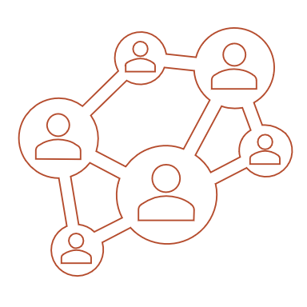
First Level DFD
A first-level DFD is like a zoomed-in view of the Context Level Diagram. It breaks down the main functions of the system into smaller steps or subprocesses. It helps to understand the detailed process of system.

Slide 16
First Level DFD
Student database
Store Data
7.Give Data
3.Store Data
Student Academics management
process
18.Send Student Result/progress
Student Enroll
process
8.Interchange Student Data for Academics
1.Stu info
10.Manage Academics Report
Student
17.submit student Grade
16.Course Information
2.Verify
9.Manage student Record
4.Assign Id
Admin
12.Manage Course Record
11 Manage Faculty Record
5.Request course Info
6.Send Course Details
Faculty rec management
process
19.Faculty Attendence
Course management
process
20.Generate Report pay salary
15.Store Data
13.Give Details
faculty
14.Assign course/Access for manage course
21.Store data
Faculty database
Course database

Slide 17
UML Diagrams
Class Diagram
Activity Diagram
Sequence Diagram
Use Case Diagram
State Transition Diagram
Component Diagram
Deployment Diagram

Slide 18
Class Diagram
Class diagrams are like blueprints for software systems. They help us understand how different parts of the system work together.

Slide 19
Department
Class Diagram
Course
-dept_id:string
-dept_name:string
-location:string
-HOD-name:string
-total_staff:int
-total_stu:int
-course_id:string
-course_name:string
-desc:string
-credit:int
-dept:Department
-teacher:Teacher
1 1..*
1 1..*
1
+setdata():void
+getdata():void
+gettotal_stu():int
+gettotal_staff():int
Admin
1
+managecoure():void
+manageteacher():void
+manageacdemi():void
+managestudent():void
-adm_id:string
-admin_name:string
-phone_no:longint
-email:string
1..*
Teacher
+manage_course():void
+manage_dept():void
+manage_student():void
+managefaculty():void
+manage_record():void
+manage_finance():void
+generate_report():void
Student
-tid:string
-tname:string
-email:string
-phoneno:longint
-sid:string
-sname:string
-gender:string
-enroll_course:Course
-email:string
-phone_no:longint
1 ..* 1
1 1..*
+managedata():void
+getdata():void
+managecoures:void
1..*
1..*
+managedata():void
+viewresult():void
+manageStudentActivities()
1..*

Slide 20
Object Diagram
Object diagram show the instances of the class that put real values in the class diagram

Slide 21
Object Diagram
Department
Course
-dept_id:”CS01”
-dept_name:comp sci
-location:”1stflor”
-HOD-name:”Mr.S.D”
-total_staff:34
-total_stu:112223
-course_id:”UBCA1”
-course_name:”BCA”
-desc:”Ug course”
-credit:22
-dept:Comp sci
-teacher:”Mr.xyz”
1 1..*
1 1..*
1
1
Admin
-adm_id:”11bca”
-admin_name:” Mr.ABC”
-phone_no:1234567890
-email:abc123@gmail.com
1..*
1
Teacher
1
Student
-tid:”01A”
-tname:”Mr.xyz”
-email:”xyz12@gmail.com”
-phoneno:8123456789
1..*
-sid:”2381019”
-sname:”Vaishnavi”
-gender:”female”
-enroll_course:”BCA”
-email:vai123@gmail.com
-phone_no:9899334511
1 ..*
1 1..*
1..*
1..*

Slide 22
Activity diagram
An activity diagram is like a step-by-step guide that shows how something is done, from start to finish. .

Slide 23

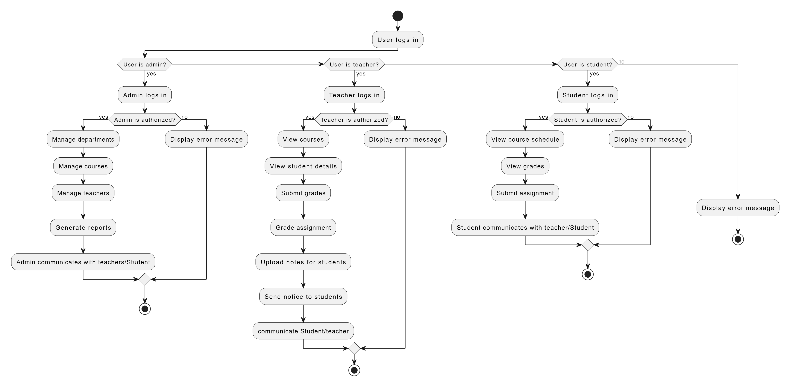
Activity Diagram

Slide 24
Sequence diagram
A sequence diagram simply depicts interaction between objects in a sequential order i.e. the order in which these interactions take place.

Slide 25
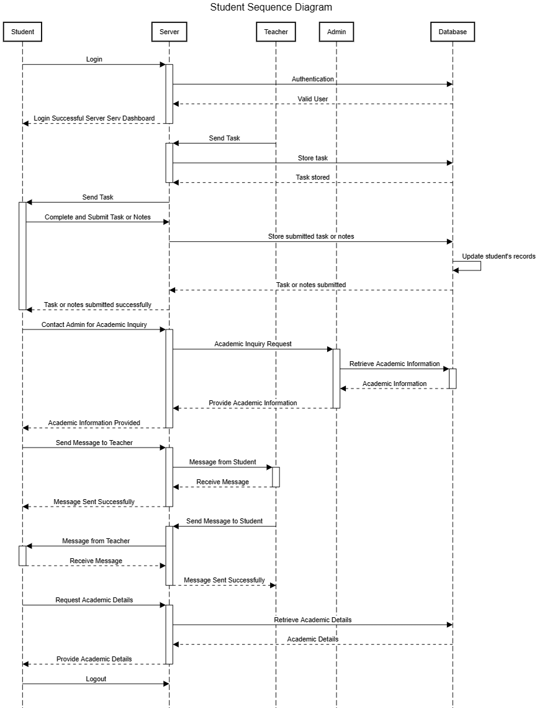

Slide 26
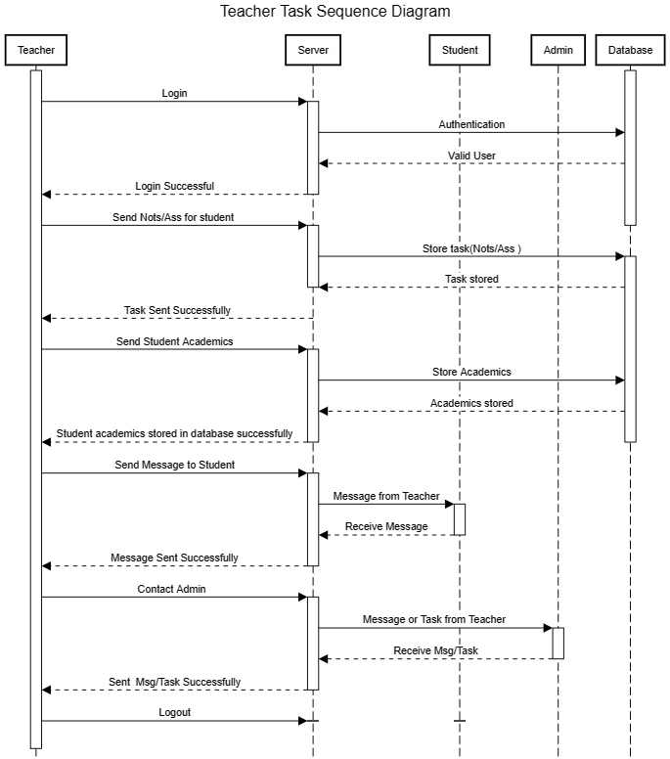

Slide 27
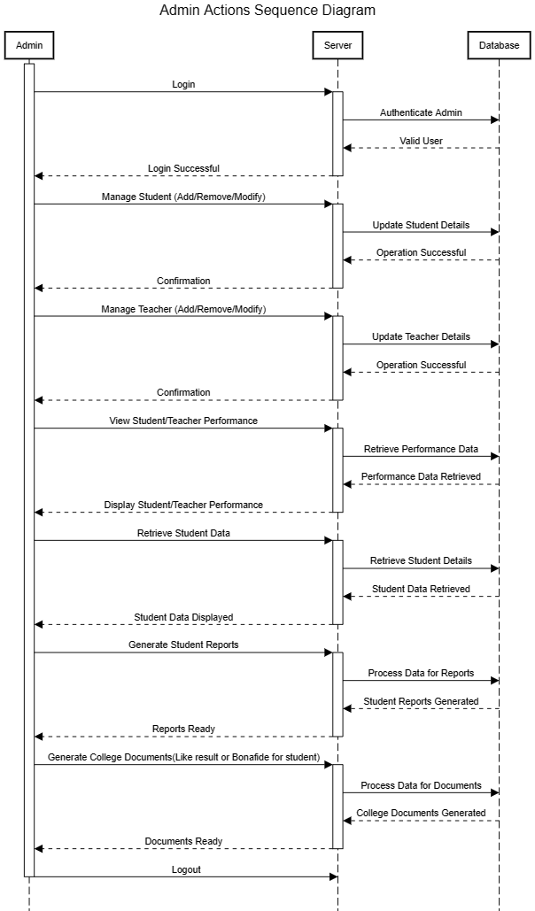

Slide 28
Use Case Diagram
It illustrates interaction between users (Actor) and System ,Focusing on functionalities or task Provided by the system …

Slide 29
Manage Student Academics and Generate Report
Manage course
Upload Notes
Manage Student
communicate S/A
Manage Teacher
Send Notice
Teacher
<<include>>
Admin
<<include>>
Login in System
<<include>>
<<include>>
Manage Department
Manage studies Task
communicate T/A
Manage finance
View Academics
Genrate system report
Student
Manage Form and fees

Slide 30
State Transition Diagram
The state transition diagram shows the order of states underwent by an object within the system.

Slide 31
Admin
1.start
Start
2.login
Login
3.Enter in profile
Profile
4.Manage
Manage
Do:Start the system
Do: Enter in system
Do: Access Data
Do: Academic
Management Stu/Tea
5.Handle Finance
8.End
Logout
7.Logout
Report
6.Genrate
Report
Finance
Do: Exit from system
Do: Generate Finance ,student , teacher report
Do: Manage Finance

Slide 32
Teacher
1.start
Start
Login
Profile
Academic
2.id/pass
3.Enter in
profile
4.Acdemics
Management
Do:Start the system
Do: Enter in system
Do: Access student Academic
Do: Send task / View task
give mark
5.Handle Reports
8.End
Logout
7.Logout
Communicate
Report
6.Messaging
Do: Exit from system
Do: messaging, Send notice, Announcement
DO: Generate Report

Slide 33
Student
1.start
Start
Login
Profile
View
2.id/pass
3.Enter in
profile
4.Acdemics
Management
Do:Start the system
Do: Enter in system
Do: Access Personal details
Do: view Task, Report
5.Sumnit Task
8.End
Logout
Communicate
Submit
7.Logout
6.Messaging
Do: Exit from system
Do: communicate With Teacher ,Admin
Do: submit Task,

Slide 34
Component diagram
A component diagram is a visual representation illustrating the different parts (components) of a software system and their interactions, serving as a blueprint for understanding and building the system's architecture.

Slide 35
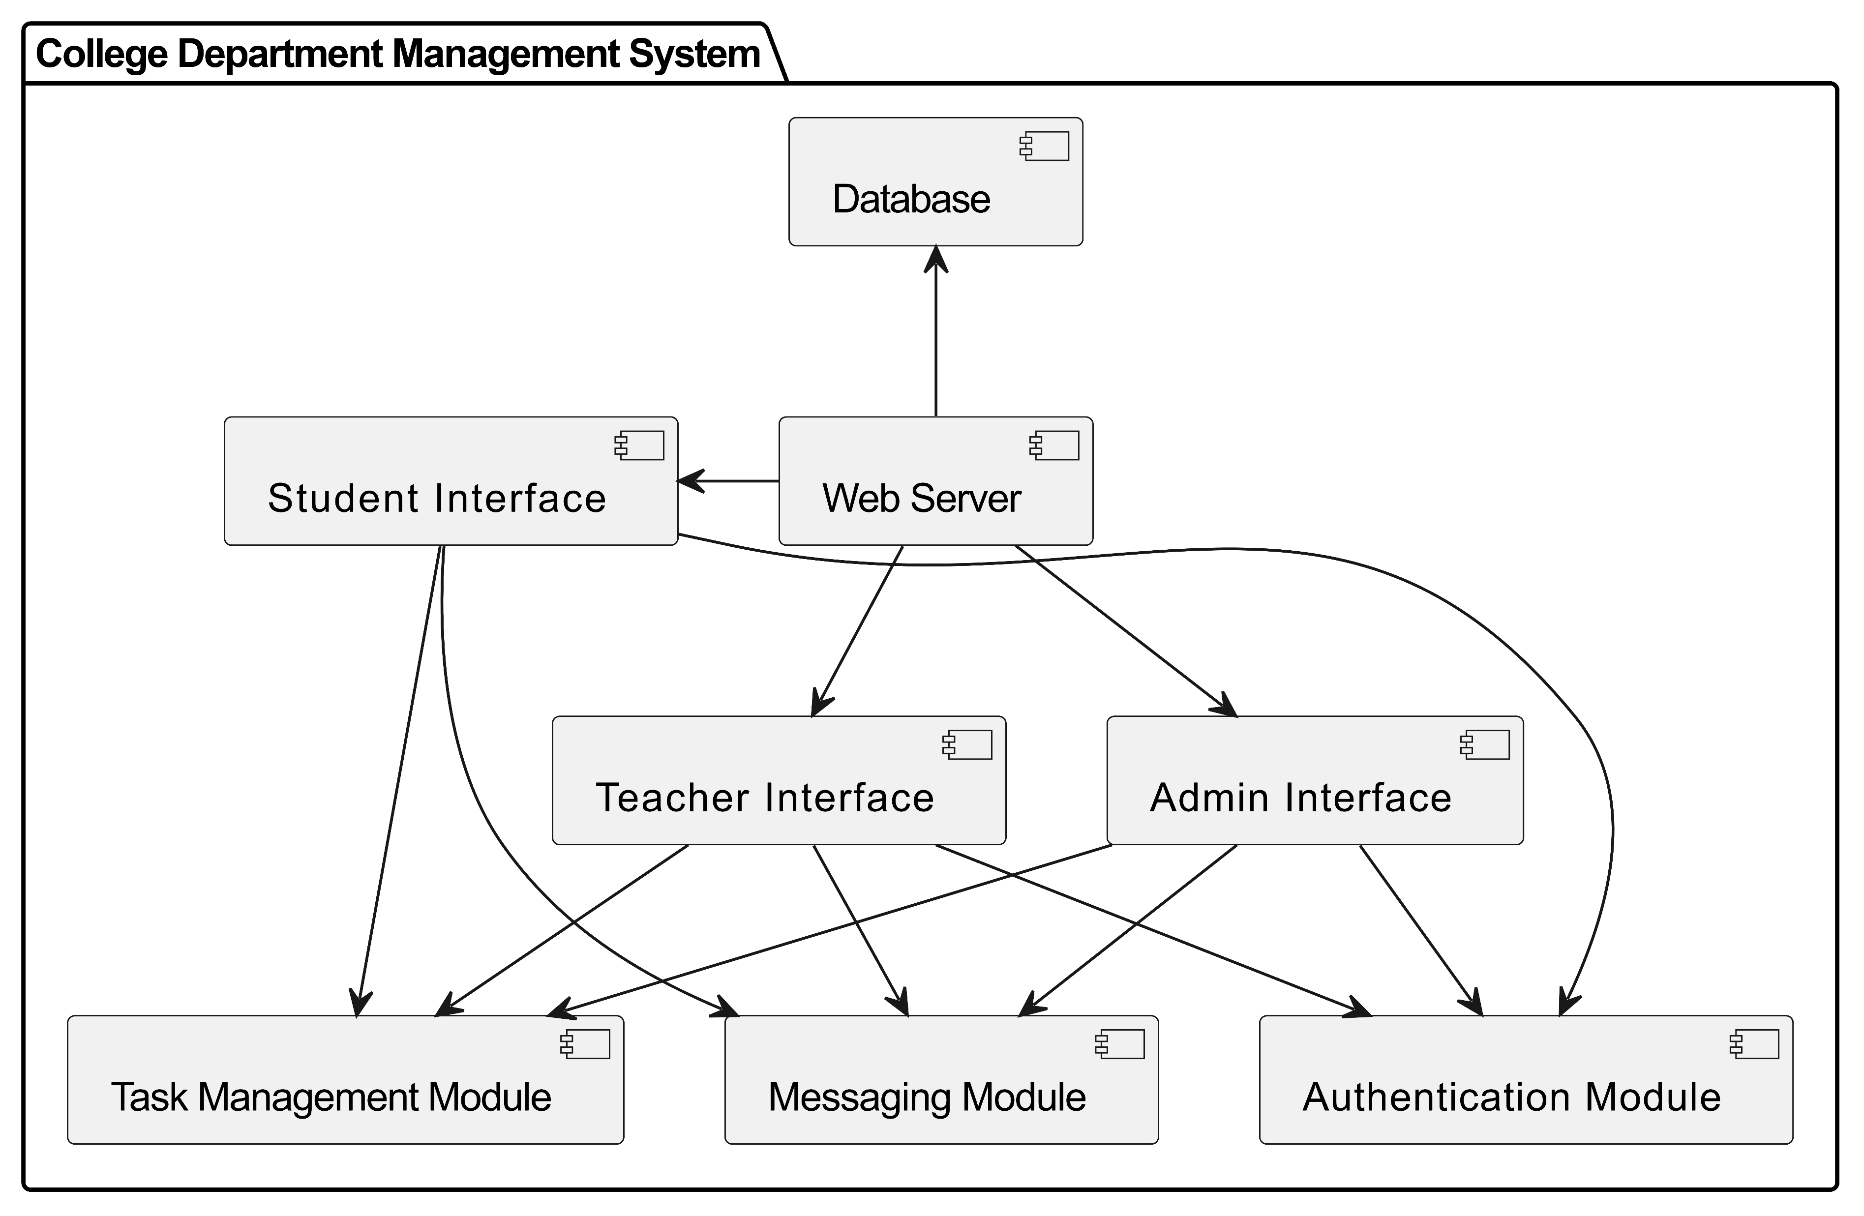
Component Diagram

Slide 36
Deployment diagram
It show the physical deployment of software components on hardware nodes , illustrating
How software artifacts are deployed…
It show physical deployment of software components on hardware nodes, application server, database server and artifacts deployed on each node…

Slide 37
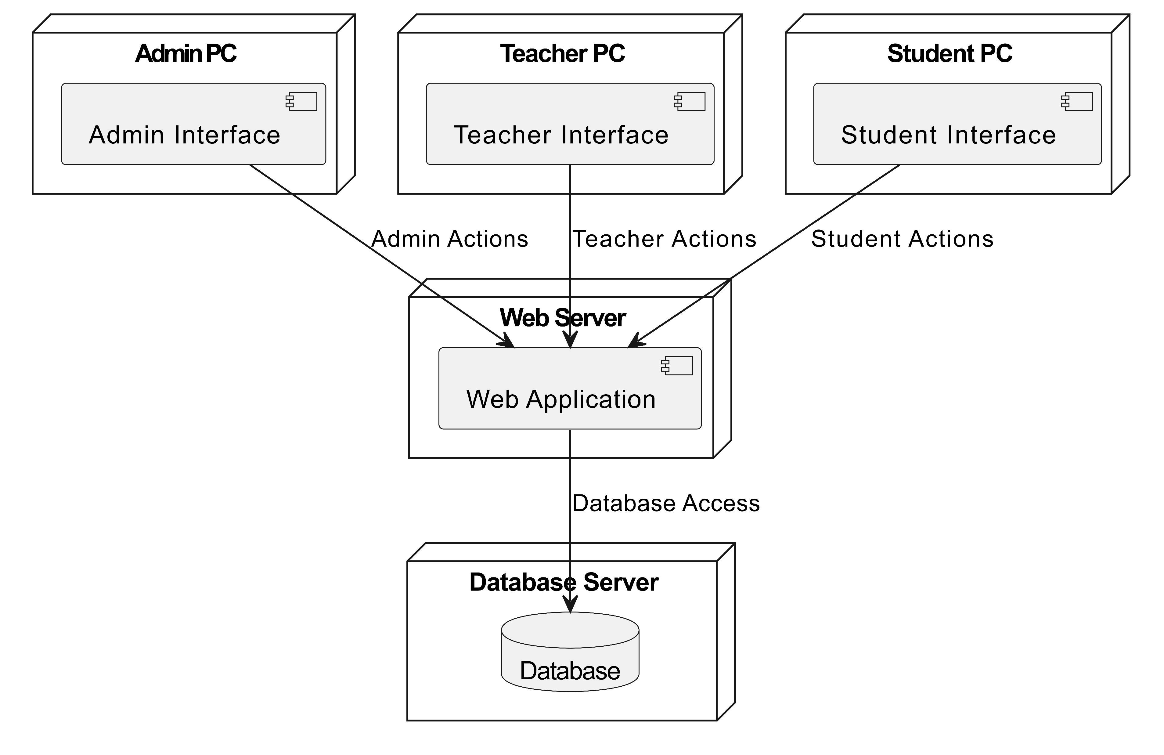
Deployment Diagram

Slide 38
CONCLUSION
In conclusion, our project aims to create a College Department Management System that helps to the administrators, students, and teachers. Through the system, administrators can efficiently manage departments, courses, students, teachers, finances, and academic activities. Students can access and submit assignments, view academic records, communicate with teachers and administrators, and complete college or exam-related tasks. Similarly, teachers can upload notes, view student assignments, manage student academics, communicate with students and administrators, send notices, and generate academic reports. Overall, our system streamlines various processes within the college department, enhancing efficiency, organization, and communication while ensuring secure access through a login process for all users.

Slide 39

THANK YOU!

